Slide 1

Operating systems
Lecture # 09

Slide 2
Lecture Overview
CPU Scheduling Algorithms – Preemptive
Shortest Remaining Time First (SRTF) (Preemptive SJF) Scheduling

Slide 3
Shortest Remaining Time First (SRTF) Scheduling
The preemptive version of Shortest Job First (SJF) scheduling is called Shortest Remaining Time First (SRTF).
In SRTF, the process with the least time left to finish is selected to run.
The running process continues until it finishes or a new process with a shorter remaining time arrives, ensuring the fastest finishing process always gets priority.

Slide 4
Advantages of SRTF Scheduling
Minimizes Average Waiting Time: SRTF reduces the average waiting time by prioritizing processes with the shortest remaining execution time.
Efficient for Short Processes: Shorter processes get completed faster, improving overall system responsiveness.
Ideal for Time-Critical Systems: It ensures that time-sensitive processes are executed quickly.

Slide 5
Disadvantages of SRTF Scheduling
Starvation of Long Processes: Longer processes may be delayed indefinitely if shorter processes keep arriving.
Difficult to Predict Burst Times: Accurate prediction of process burst times is challenging and affects scheduling decisions.
High Overhead: Frequent context switching can increase overhead and slow down system performance.
Not Suitable for Real-Time Systems: Real-time tasks may suffer delays due to frequent preemptions.

Slide 6
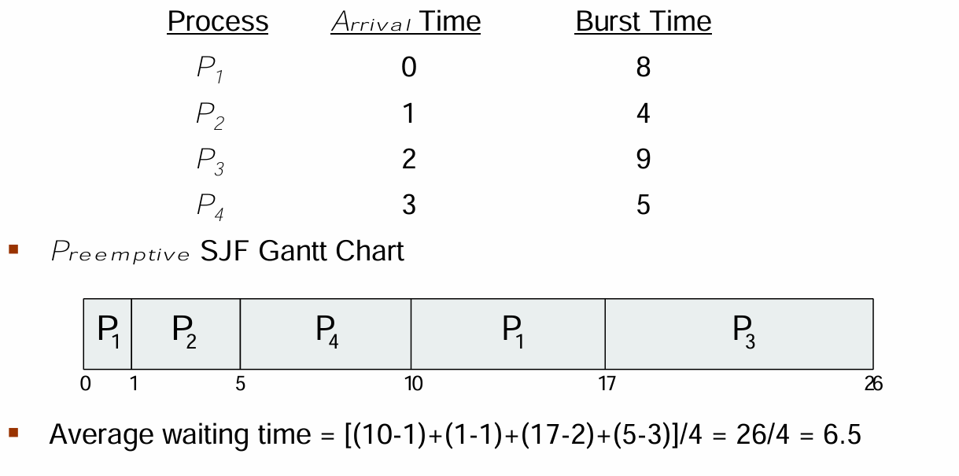

Slide 7
Shortest Remaining Time First (SRTF) Scheduling
Criteria – Burst Time
Mode - Preemptive
Solved Example
Process | Arrival Time (AT) | Burst Time / Execution Time | Completion Time (CT) | Turnaround Time (TAT) | Waiting Time (WT) | Response Time (RT)
P1 | 0 | 5 | 9 | 9 | 4 | 0
P2 | 1 | 3 | 4 | 3 | 0 | 0
P3 | 2 | 4 | 13 | 11 | 7 | 7
P4 | 4 | 1 | 5 | 1 | 0 | 0
Gantt Chart
P1 | P2 | P2 | P2 | P4 | P1 | P1 | P1 | P1 | P3
0 1 2 3 4 5 6 7 8 9 13
Time

Slide 8
Shortest Remaining Time First (SRTF) Scheduling
Question:
Consider the following set of processes with their Arrival Time and Burst Time (in milliseconds).
Criteria – Burst Time & Mode – Preemptive. find:
Turnaround Time (TAT)
Waiting Time (WT)
Average Turnaround Time (AVG TAT)
Average Waiting Time (AVG WT)
Total Time of Process Execution
Process | Arrival Time (AT) | Burst Time / Execution Time
P1 | 0 | 8
P2 | 1 | 4
P3 | 2 | 9
P4 | 3 | 5

Slide 9
Thank you!
“Your work on the OS layer makes every application possible!”

